Slide 1
DECK CONSTRUCTION 101
PROFESSIONAL TRAINING OUTLINE
Brought to you by General Woodcraft, Inc. and MataverdeDecking.com, New London, CT and Cotati, CA
© 2024 General Woodcraft Inc

Slide 2
PLANNING & DESIGN CONSIDERATIONS
Where are you planning to build the deck?
What size?
How high off the ground?
What activities do you plan for your deck?
Is there enough space for each activity?
Will you need separate areas for each activity? Multi-level?
Benches? Stairs? Privacy screening?
Overhead structures?
Budget? (ballpark estimate = $25-$35/sf + $100/lf railings + Stairs++)
© 2024 General Woodcraft Inc

Slide 3
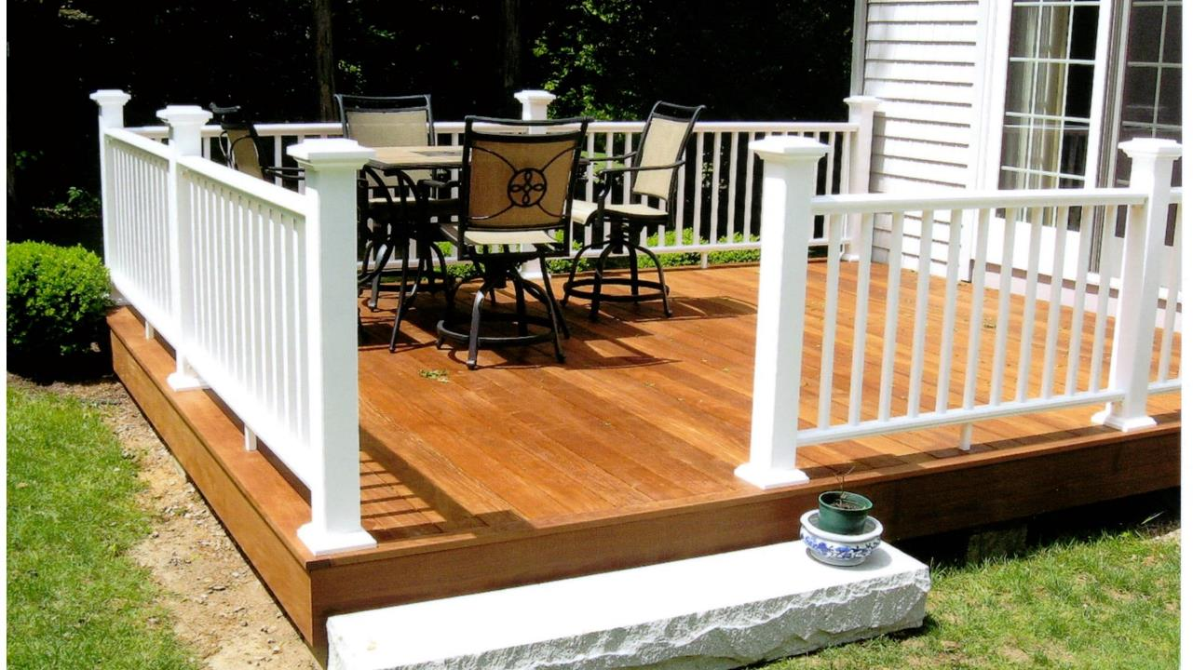
DESIGN IDEAS
Single level decks are simpler and less expensive to build.
© 2024 General Woodcraft Inc

Slide 4
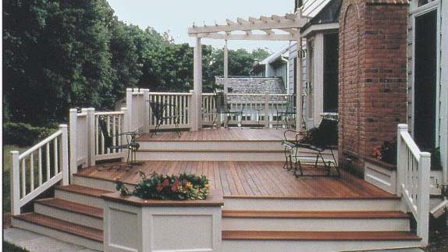
DESIGN IDEAS
Low clearance decks have unique design challenges, including ventilation and drainage concerns.
© 2024 General Woodcraft Inc

Slide 5
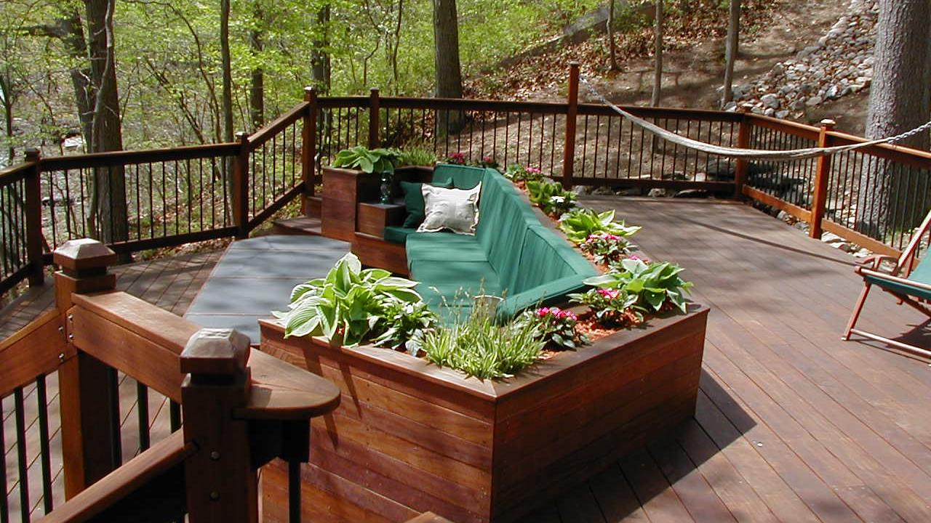
DESIGN IDEAS
Multilevel decks create separate areas for designed activities
© 2024 General Woodcraft Inc

Slide 6
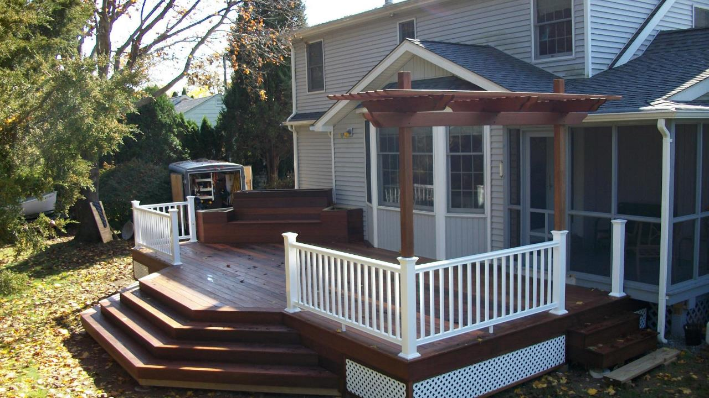
DESIGN IDEAS
Decks with overhead design elements may require special framing, beams, and footings.
© 2024 General Woodcraft Inc

Slide 7
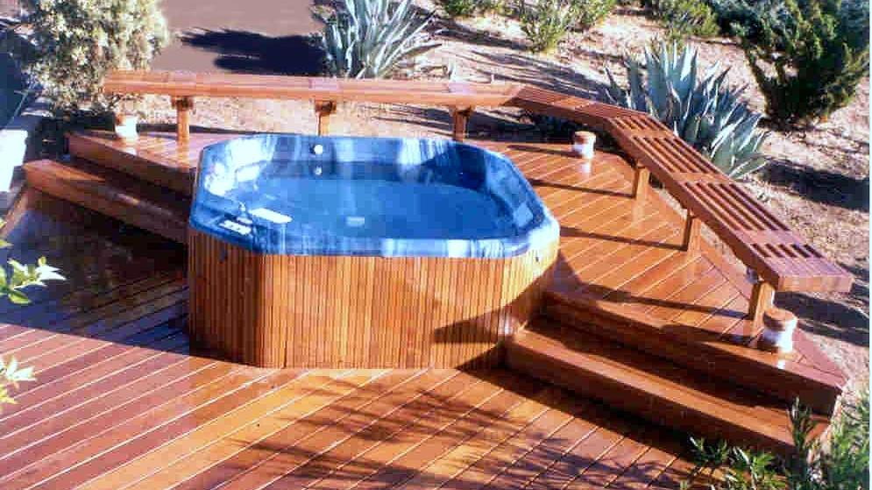
DESIGN IDEAS
Decks with hot tubs or other heavy “dead loads” require special framing, beams and footings.
© 2024 General Woodcraft Inc

Slide 8
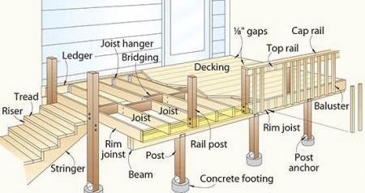
DECK FRAMING BASICS
© 2024 General Woodcraft Inc

Slide 9
DECK FRAMING TERMS AND COMPONENTS
Beams:
Hefty framing members (usually 4x, 6x, or doubled or tripled 2x stock) attached horizontally to the posts to support the joists.
© 2024 General Woodcraft Inc

Slide 10
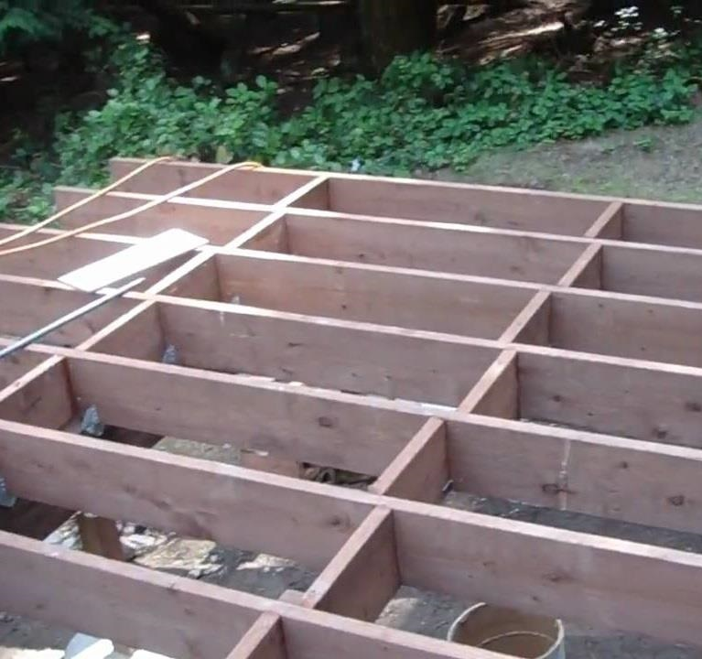
DECK FRAMING TERMS AND COMPONENTS
Bridging:
Short pieces of lumber between joists that strengthen the framing. They are designed to prevent the joists from twisting.
© 2024 General Woodcraft Inc

Slide 11
DECK FRAMING TERMS AND COMPONENTS
Footings:
Concrete columns below grade that support the posts and, thus, the deck. On sites where the soil freezes and thaws, concrete is poured in an above-grade form and a cylindrical hole.
Footings are typically required for all attached decks. Ask your building department for footing depths and code requirements in your area.
© 2024 General Woodcraft Inc

Slide 12
DECK FRAMING TERMS AND COMPONENTS
Joists:
Horizontal framing members (usually 2x stock) fastened on top of the beam or flush with the ledger to support the decking. A header is fastened to the ends of the deck’s interior joists. Rim joists or end joists are the outermost joists parallel to the ledger.
© 2024 General Woodcraft Inc

Slide 13
DECK FRAMING TERMS AND COMPONENTS
Ledger:
A board (usually 2x stock) attaches to the house to support one side of the deck.
Proper fastening is required by building codes.
© 2024 General Woodcraft Inc

Slide 14
DECK FRAMING TERMS AND COMPONENTS
Posts:
Timbers (usually 4x or 6x) set vertically to support the deck framing. Posts are used on all but the shortest decks. The posts can be cut off below the deck surface, or they may rise above the surface to provide support for the railing. Posts should rest on top of concrete footings.
© 2024 General Woodcraft Inc

Slide 15
DECK FRAMING TERMS AND COMPONENTS
Stairs:
Risers Boards covering the vertical spaces between stairway treads. (Often omitted on deck steps and other exterior steps.)
Stringers Long, diagonal framing parts (usually 2x12s) that support stair treads. They are usually notched.
Treads The horizontal stepping surfaces of a stairway. The stair treads are attached to the stringers.
© 2024 General Woodcraft Inc

Slide 16
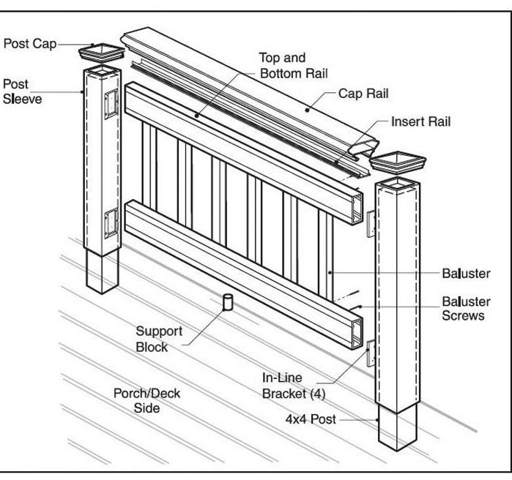
DECK FRAMING TERMS AND COMPONENTS
Railing:
The assembly made of rails, rail posts, cap rails, and balusters or spindles. The balusters, the smallest vertical components, are positioned to fill the space between the top and bottom rails and between rail posts.
Regardless of material used, there are code requirements for the height of the railing and spacing of the balusters that must be met.
© 2024 General Woodcraft Inc

Slide 17
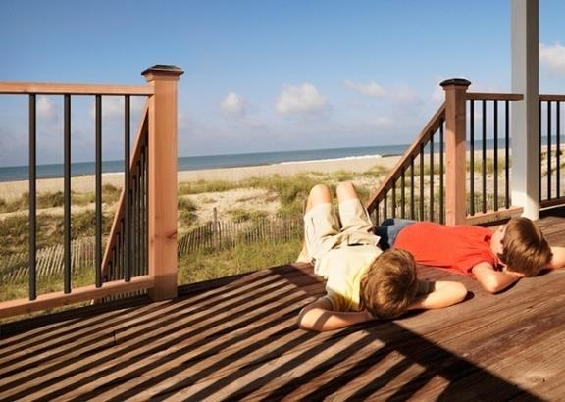
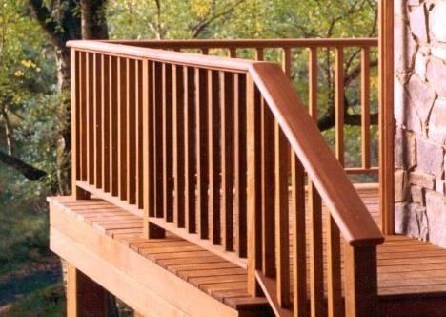
Deck Railing Systems
Railings come in many options of configuration and materials
© 2024 General Woodcraft Inc

Slide 18
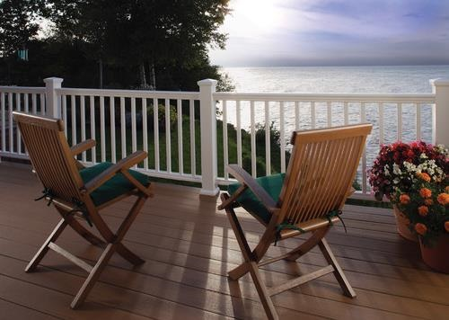
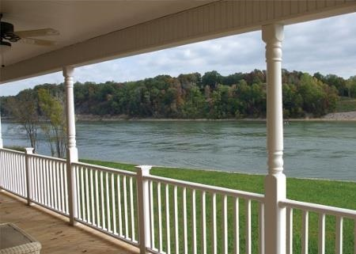
Deck Railing Systems
Railings come in many options of configuration and materials
© 2024 General Woodcraft Inc

Slide 19
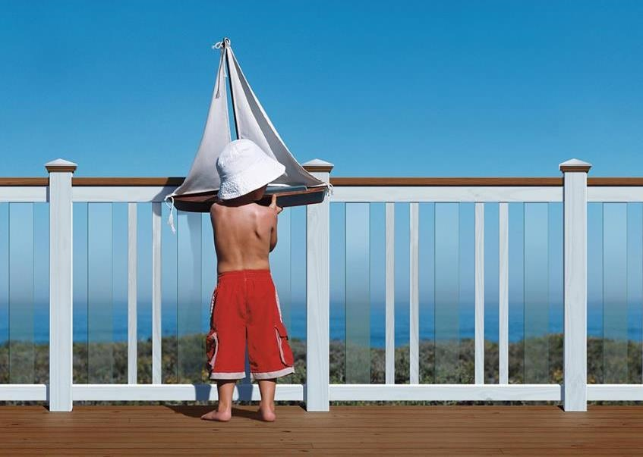
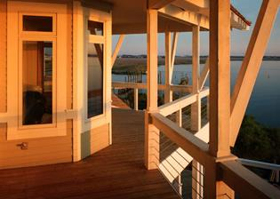
Railings come in many options of configuration and materials
Deck Railing Systems
© 2024 General Woodcraft Inc

Slide 20
END OF SECTION
Thank you for completing this online training.
Brought to you by General Woodcraft, Inc. and MataverdeDecking.com , New London, CT and Cotati, CA
Return To The Page To Proceed To Testing
© 2024 General Woodcraft Inc

