Slide 1
CLIMATE-SHIELD WOOD RAINSCREEN DESIGN OPTIONS
PROFESSIONAL TRAINING OUTLINE
Brought to you by General Woodcraft, Inc. and MataverdeDecking.com , New London, CT and Cotati, CA
© 2020 General Woodcraft Inc.

Slide 2
SECTION 1: Why Specify a Wood Rainscreen?
Definitions, History, Drivers, and Benefits
© 2020 General Woodcraft Inc.

Slide 3
Why Use Wood?
Archeological discoveries in England reveal that wood has been used in construction for over 8,000 years.
Wood is a naturally beautiful, organic construction material and design element.
Wood is readily available, easy to build with, and has natural insulative properties.
Wood is one of the few renewable natural resources that will replenish within our lifetimes.
© 2020 General Woodcraft Inc.

Slide 4
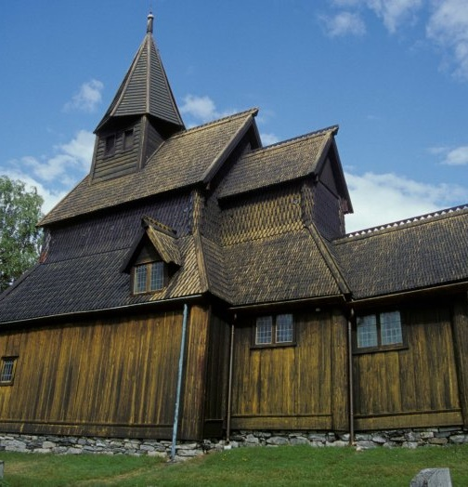
Original wood rainscreen built circa 1180 AD, on a stave church in Urnes, Norway
Definition of a Rainscreen
And What You Should Know About Them
A rainscreen, by definition, is a system not a single product, that shields the building envelope (exterior) from weather.
It starts with an inner weatherproofed ‘building envelope’
Then, the exterior cladding is placed away from the building envelope
This creates a drainable ‘rain screen gap’ or ‘wall cavity’ to keep the weather outside the structure and other benefits
© 2020 General Woodcraft Inc.

Slide 5
Why Rainscreens Are Specified
Key Drivers:
Building code changes result in U.S. and Canadian architects paying more attention to rainscreens.
The sustainable design movement in U.S. architectural circles enhanced awareness of the benefits of a properly designed rainscreen in the design community.
Health, Safety and Welfare (HSW), requirements rule the day in modern architectural learning and training, 18 credits per year.
Appearance. Wood rainscreens are frequently specified for their natural beauty above and beyond the design benefits and code requirements.
© 2020 General Woodcraft Inc.

Slide 6
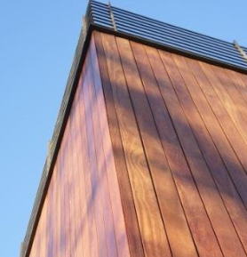
Benefits To A
Well-Designed Rainscreen
Protects the exterior from wind-driven rain, sleet, snow and other weather.
Creates an egress behind the cladding for moisture and bulk water to escape.
Allows interior moisture to egress to the outside of the building envelope.
Provides a passive thermal layer in the rainscreen gap (wall cavity).
© 2020 General Woodcraft Inc.

Slide 7
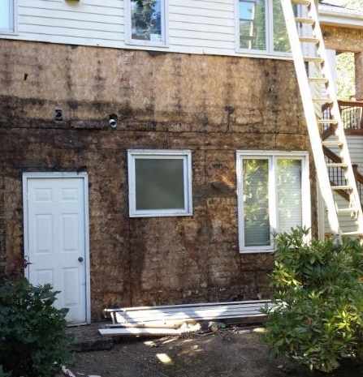
Consequences Of Not Using A Rainscreen
The structure can’t “breathe”.
Trapped moisture has no where to escape.
Moisture leads to mold, then to rot, then to decay causing:
Health concerns
Structural issues
Mold lawsuits are a Billion-dollar industry.
© 2020 General Woodcraft Inc.

Slide 8
SECTION 2: Different Types of Wood Rainscreens
Approaches, Materials, Features And How They Work
© 2020 General Woodcraft Inc.

Slide 9
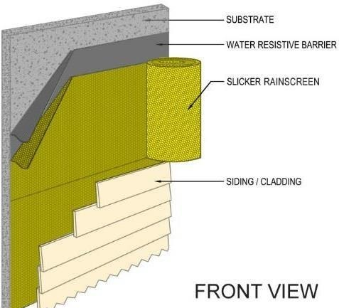
Basic Wood Rainscreen Type: Wood siding with a back ventilated rainscreen
Protects the exterior from weather
The system, (WRB), slicker and siding, work together to create a rainscreen.
Back ventilated
Closed joint
Non-pressure equalized
Minimal rainscreen gap
Better alternative than not having a rainscreen gap (wall cavity)
FYI: “Slicker rainscreen” by itself is not a rainscreen. The rainscreen system you see here is the WRB, the rainscreen gap formed by the Slicker and the cladding.
© 2020 General Woodcraft Inc.

Slide 10
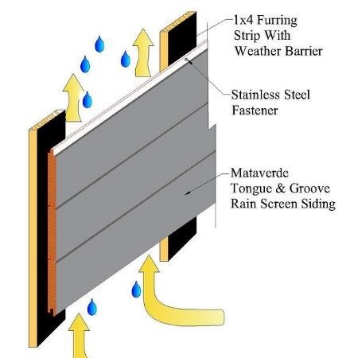
Basic Wood Rainscreen Type: Wood siding over furring strips
Protects the exterior from weather
Back ventilated
Closed joint
Non-pressure equalized
¾” Rainscreen gap (ideal wall cavity for wood)
But the furring strips cover about 20% of the building envelope, so…
From an egress standpoint of moisture from the inside, this method is only 80% effective, by design, because of the furring strips.
© 2020 General Woodcraft Inc.

Slide 11
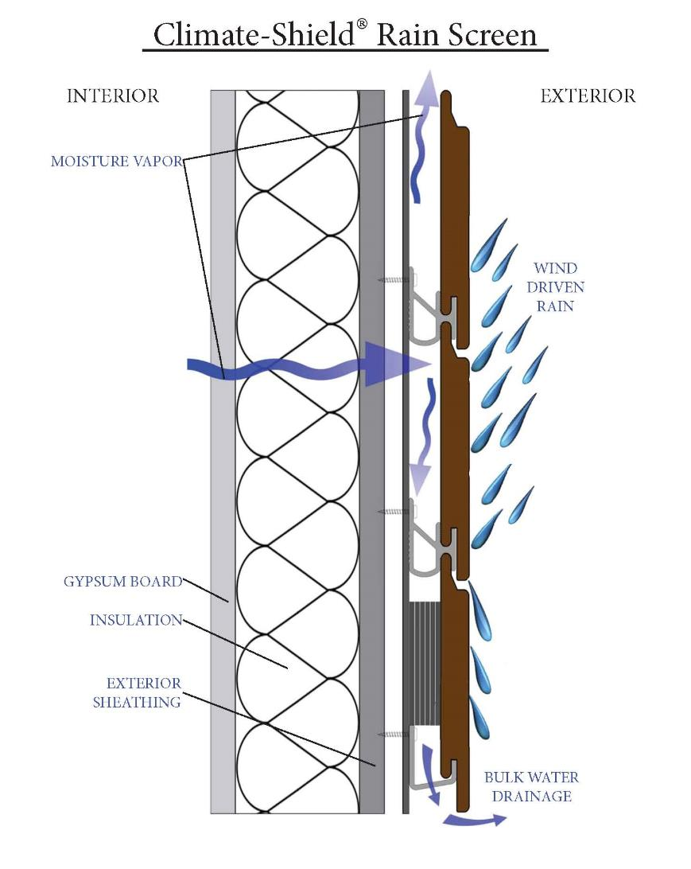
How A Well-Designed Rainscreen Works
The siding (sheds most bulk water)
Back ventilated (drains)
Open joint (breathes)
Pressure equalized (dries quickly, best ventilation and wind load performance)
These three components, when combined, create the highest performance criteria for wood rainscreens
© 2020 General Woodcraft Inc.

Slide 12
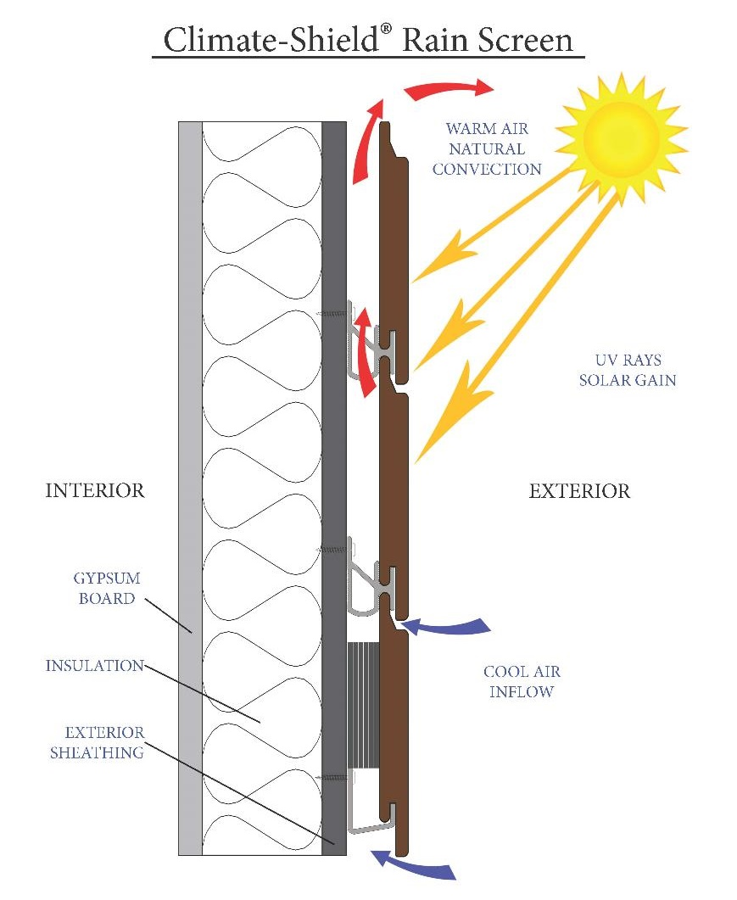
How A Well-Designed Rainscreen Works
“Rainscreens” (not just for rain)
Back ventilated (drains and vents)
Open joint (best ventilation)
Pressure equalized (dries quickly, best ventilation and wind load performance)
Natural Energy savings in cold or warm weather
© 2020 General Woodcraft Inc.

Slide 13
SECTION 3: Climate Shield® Components
How to Create a Well-Designed Wood Rainscreen
© 2020 General Woodcraft Inc.

Slide 14
Climate-Shield® Components Chart
System Components→ | Climate-Shield CS 2 | Climate-Shield CS 10 | Climate-Shield CST 1
↓Design Requirement↓
Cladding type | Wood rainscreen | Wood rainscreen | Trespa Pura rainscreen
Rainscreen gap | ¾” | 10 mm (3/8”) | ¾”
Wind/Seismic Load | 220 MPH + | 180 MPH + | 170 MPH +
Fully pressure equalized | YES | YES | YES
Siding orientation | Horizontal, Vertical, Diagonal | Horizontal | Horizontal, Vertical
Soffits | YES | YES | YES
Over Plywood/OSB sheathing | YES | YES | YES
Over non-structural sheathing | YES | NO | NO
© 2020 General Woodcraft Inc.

Slide 15
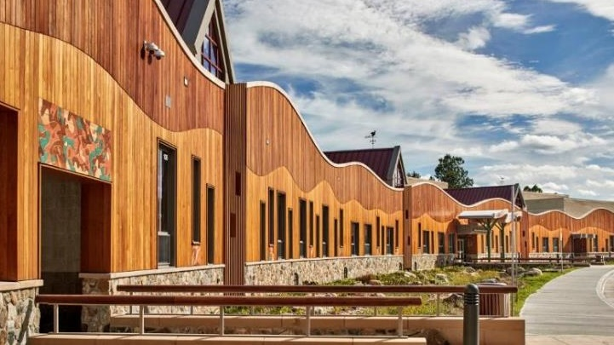
WHY specify the
Climate-Shield CS 2 System Components?
Strongest and most robust design
Uses 2 screws per rainscreen clip
Superior wind / seismic design values
Commercial or residential
Vertical, horizontal or diagonal
© 2020 General Woodcraft Inc.

Slide 16
Wherever wood cladding is the preferred design element
Plywood or OSB walls
Masonry walls (with CSAC8 attachment channel)
Exterior gypsum walls (with CSAC8 attachment channel)
Z-girts with exterior insulation
Any hurricane / high wind zone area
WHERE
to specify the Climate-Shield CS 2 System Components
© 2020 General Woodcraft Inc.

Slide 17
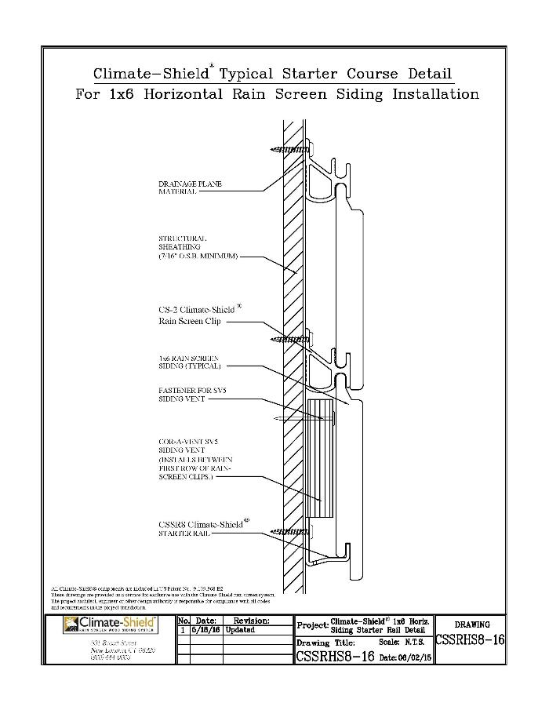
WHERE to Specify the Climate-Shield CS 2 System Components
Horizontal cladding designs
Wherever wood cladding is the preferred design element
Plywood or OSB walls
© 2020 General Woodcraft Inc.

Slide 18
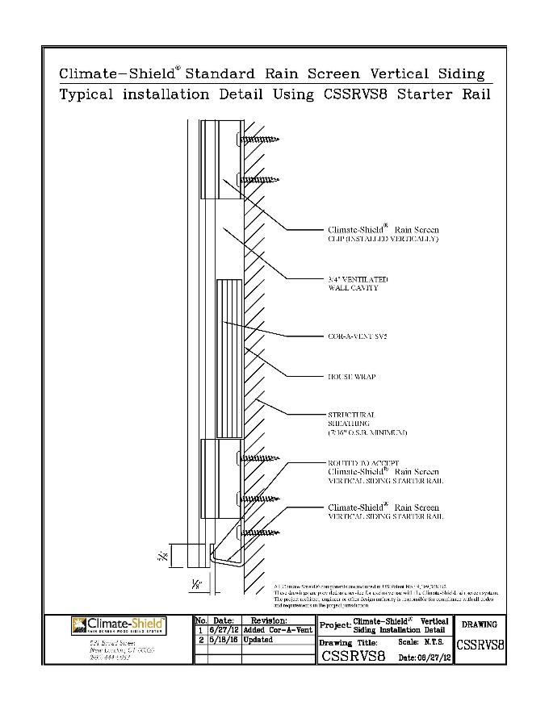
WHERE to Specify the Climate-Shield CS 2 System Components
Vertical cladding designs
Wherever wood cladding is the preferred design element
Plywood or OSB walls
© 2020 General Woodcraft Inc.

Slide 19
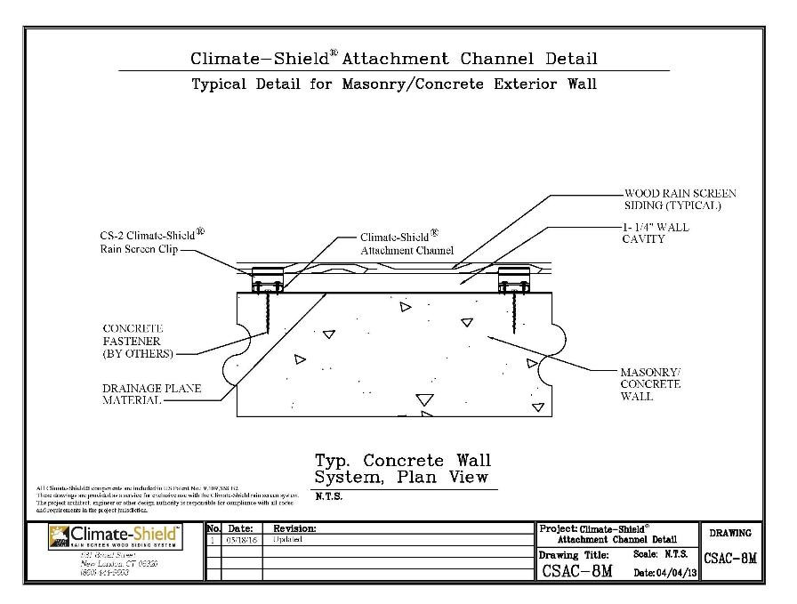
WHERE to Specify the Climate-Shield CS 2 System Components
Masonry walls with Climate-Shield CSAC 8 Attachment Channel
Wherever wood cladding is the preferred design element
© 2020 General Woodcraft Inc.

Slide 20
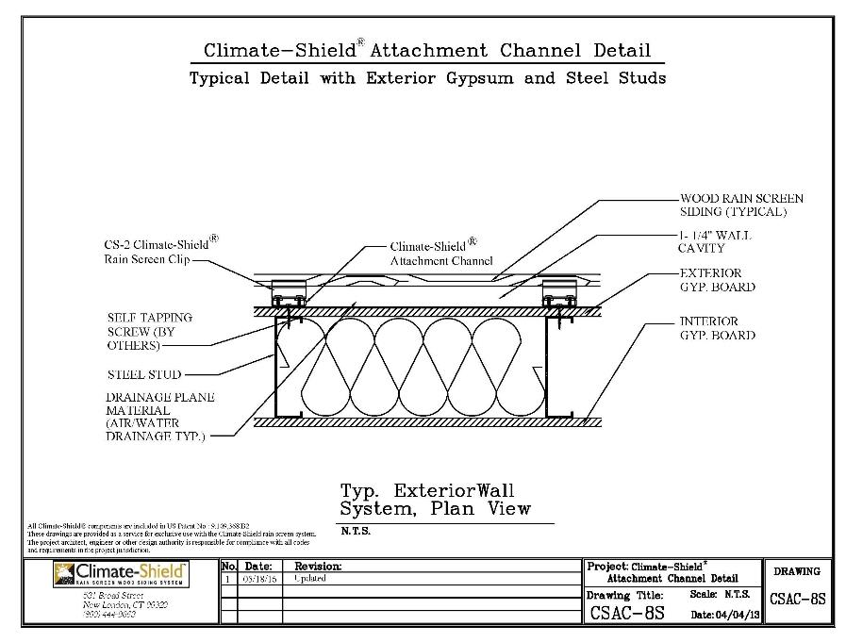
WHERE to Specify the Climate-Shield CS 2 System Components
Exterior Gypsum with Climate-Shield CSAC 8 Attachment Channel
Wherever wood cladding is the preferred design element
© 2020 General Woodcraft Inc.

Slide 21
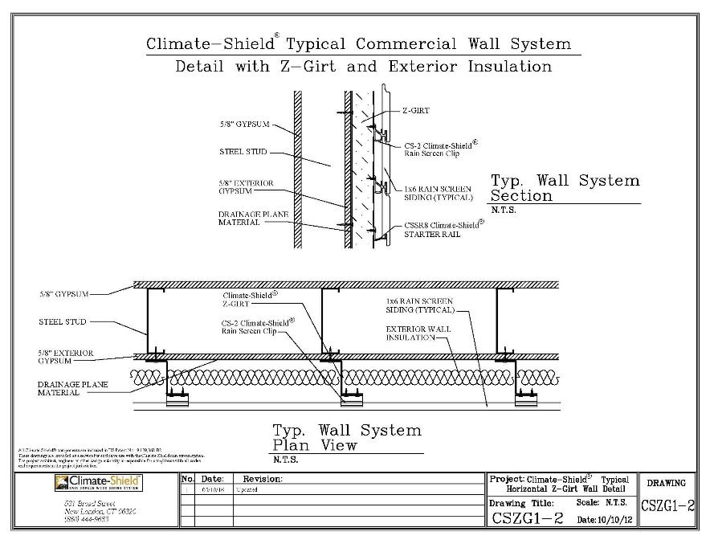
WHERE to Specify the Climate-Shield CS 2 System Components
Exterior Insulation and Climate-Shield CSZ8 Z-Girts
Wherever wood cladding is the preferred design element
© 2020 General Woodcraft Inc.

Slide 22
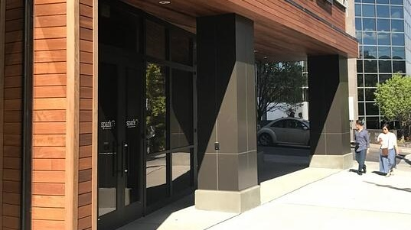
WHY specify the Climate-Shield CS 10 System Components?
Uses 1 screw per rainscreen clip
Wind / seismic design values of 180 MPH or lower
To meet window elevations without additional trim
Horizontal siding designs
Soffits
© 2020 General Woodcraft Inc.

Slide 23
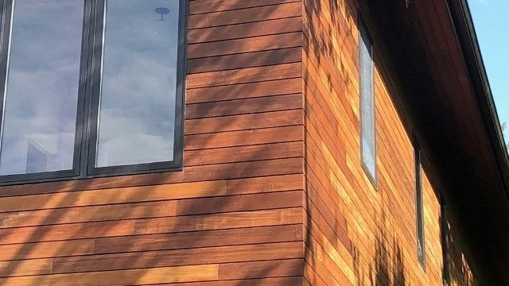
WHERE to specify the Climate-Shield CS 10 System Components
Where wood cladding is the preferred design element
Over plywood/OSB sheathing
Wind / seismic design values of 180 MPH or lower
To meet window elevations without additional trim
Horizontal siding designs
© 2020 General Woodcraft Inc.

Slide 24
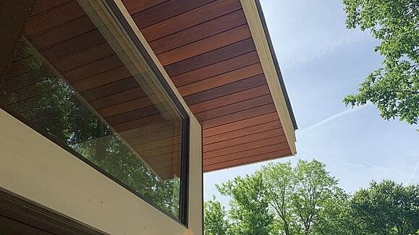
WHERE to specify the Climate-Shield CS 10 System Components
Where wood cladding is the preferred design element
Over plywood/OSB sheathing
Wind / seismic design values of 180 MPH or lower
Soffits
© 2020 General Woodcraft Inc.
© 2020 General Woodcraft Inc.

Slide 25
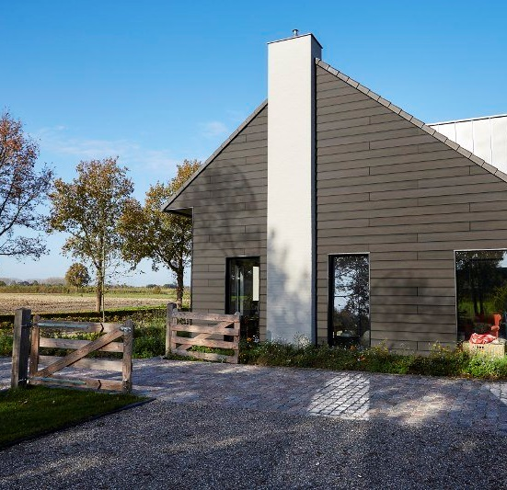
WHY specify the Climate-Shield CST1 System Components?
Where Trespa Pura HPL cladding is the preferred design element
Uses 1 screw per rainscreen clip
Wind / seismic design values of 170 MPH or lower
Horizontal, vertical siding designs
Soffits
© 2020 General Woodcraft Inc.

Slide 26
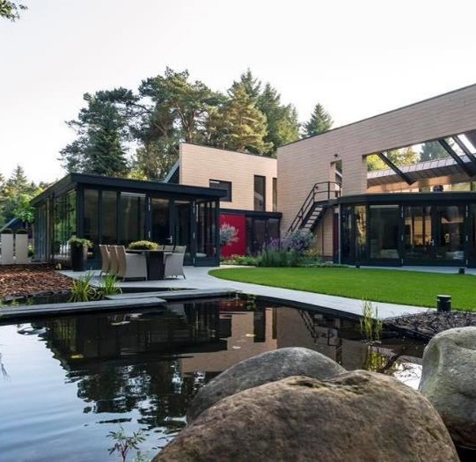
WHERE to specify the Climate-Shield CST1 System Components
Where Trespa Pura HPL cladding is the preferred design element
Over plywood / OSB sheathing
Wind / seismic design values of 170 MPH or lower
Horizontal, vertical siding designs
© 2020 General Woodcraft Inc.

Slide 27
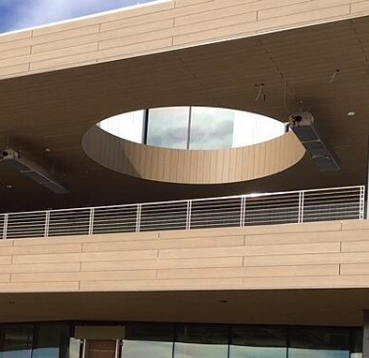
WHERE to specify the Climate-Shield CST1 System Components
Where Trespa Pura HPL cladding is the preferred design element
Over plywood / OSB sheathing
Wind / seismic design values of 170 MPH or lower
Soffits
© 2020 General Woodcraft Inc.

Slide 28
END OF SECTION
Thank you for completing this online training.
Brought to you by General Woodcraft, Inc. and MataverdeDecking.com , New London, CT and Cotati, CA
Return To The Page To Proceed To The Test
© 2020 General Woodcraft Inc.

