Slide 1

How Exterior Hardwood Decking and Siding Weathers
PROFESSIONAL TRAINING OUTLINE
© 2020 General Woodcraft Inc

Slide 2
Knowing
Weathering Effects of Premium Hardwood Decking and Siding
Clients choose high-density hardwood for their decking or siding project because of its natural beauty, high strength and superior durability. Whether you choose Ipe, Garapa, Machiche or Cumaru hardwood for your exterior projects, there are appearance options that can meet the consumer’s lifestyle choices. Because these high-density exterior hardwoods are natural wood products, we often hear questions, such as:
• What happens to hardwoods after they are installed outdoors?
• How will my hardwood turn gray?
• What if I like the ‘new wood’ look?
• What if I want the gray ‘weathered wood’ look?
• What are my maintenance options?
The first half of the answers to these questions can be found in the natural weathering process, the other half of the answer is entirely up to you and your appearance preference. We will break down these answers for you in this training.
© 2020 General Woodcraft Inc

Slide 3
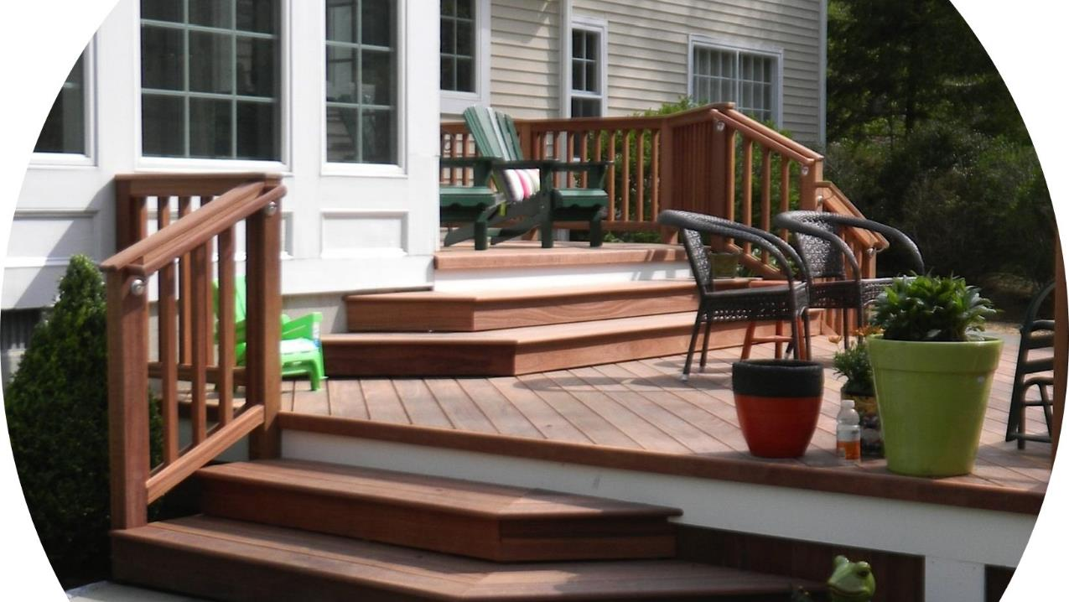
As exterior hardwoods weather, several things happen under these two headings:
All wood moves. All the time. Wood expands and contracts; changes dimensions, both initially and then seasonally ever after.
The wood will react. This happens with the the effects of outdoor exposure, including ultraviolet (UV) rays, wet and dry cycles and other weather factors. All of these will alter the hardwood’s appearance over time.
© 2020 General Woodcraft Inc

Slide 4
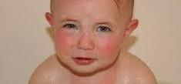
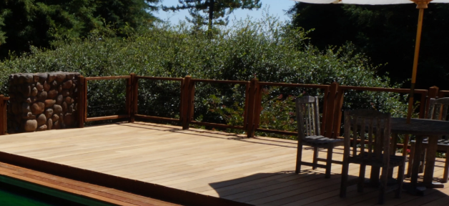
How to
Protect Your
Hardwood Investment
Because high performance exterior hardwoods are known to last so long, they are often considered ‘investment quality’ decking and siding options. And, as every investor knows, it is best to protect your investment. With exterior hardwoods, this means always protect the surface of the wood with an initial coat of a UV inhibitive sealer. Think of it as preventative maintenance – it’s like putting on suntan lotion before you go to the beach.
Best protection option: Hardwood decking, or siding would be pre-finished before it arrives on your site.
Next best protection option: Apply a UV coating before installation. Coat all 4 sides of the wood.
Third best protection option: Apply a UV coating immediately after installation. Although you won’t be able to coat all 4 sides of the board, you will still be able to coat the exposed face.
All these options help minimize surface checking and protect the wood as it seasons on site.
Please mommy, use a UV inhibitor to protect your investment
© 2020 General Woodcraft Inc

Slide 5
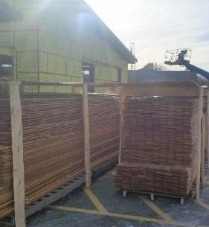
First Step:
Acclimate, Acclimate,
Acclimate
To help control the dimensional changes initially, wood must be properly acclimated to on-site moisture conditions. This essential step will help minimize surface checking and improve wood usage and overall performance.
Regardless of your decking or hardwood siding species, the first step to a
successful project is to always acclimate your exterior hardwoods on-site properly
until they adapt to their new environment. During this acclimation period, wood will
move and change dimension. Most of this on-site ‘movement’ is typically widthwise shrinkage. For best looks, performance and results, it is imperative that the acclimation be completed before installation. The image to the right shows best demonstrated practices for on-site storage and acclimation.
(SEE OUR PROPER WOOD ACCLIMATION FOR EXTERIOR WOOD ONLINE TRAINING FOR MORE INFORMATION ON BEST ACCLIMATION PRACTICES.)
© 2020 General Woodcraft Inc

Slide 6
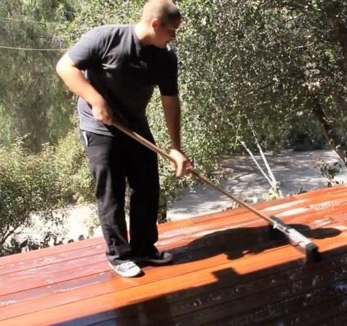
Annual Cleaning
Regardless of the choice of finish or material for your decking or siding, an annual cleaning is essential for the best appearance. Regardless of whether you are using wood, composite, vinyl, cement, metal or other, removing dirt, debris and detritus yearly is always a good idea.
Exterior hardwood decking, or siding is no exception. For best looks – keep it clean. A little bit of care and maintenance goes a long way.
© 2020 General Woodcraft Inc

Slide 7
What
Are My Appearance
Options?
New Hardwood If the client prefers the “new” appearance of the decking or siding and wishes to maintain it, plan to re-finish hardwood decking or siding as desired (usually once every year or two) depending on site conditions, type of finish and other variables.
Weathered Gray Patina The hardwood can be allowed to weather and mature over time for a low maintenance natural silvery gray patina. This option would still require a UV inhibitor finish and maintenance to protect the wood from sun damage.
“Third option” At any time in the life of the decking or siding, the end consumer can change their mind to suit their needs and lifestyle. If they decide they want the pre-finished material to weather out, it can be left to wear the finish off. Or strip the finish to weather naturally more quickly. Then allow it turn a silvery gray. Or, the reverse is true. A weathered deck can be finished over the gray patina, or the gray patina can be stripped, and the revealed wood underneath can be finished as they wish. Again, either option should include a UV inhibitor finish.
© 2020 General Woodcraft Inc

Slide 8
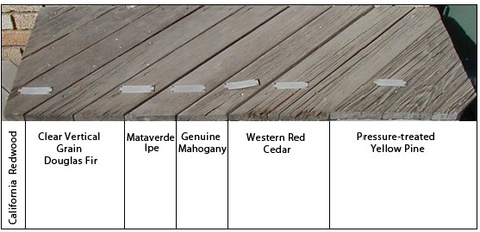
What Are My Appearance
Options?
15 YEAR TEST
WITHOUT a finish , and after 15 years of direct UV exposure,
all softwood decking species degraded.
Unfinished high-density Ipe hardwood is fully intact.
Exposure to UV rays and water are the two most damaging weather effects on outdoor wood. And not just from an appearance standpoint, it also affects performance.
Softwood decking and siding needs to be maintained. When softwoods start to turn gray, their performance is affected. Especially decking. Failure to maintain a finish on softwoods will shorten their usable lifespan.
On the other hand, high density hardwood decking and siding will last a long time, even after they start to turn gray. High density hardwoods are proven to be extremely durable. See the 15 Year Test example shown here.
© 2020 General Woodcraft Inc

Slide 9
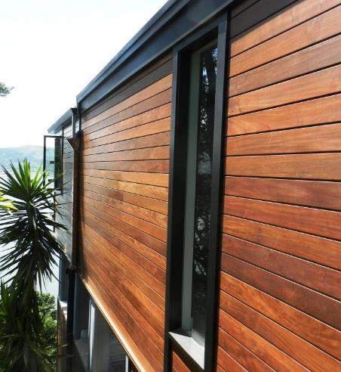
What Are My Appearance
Options?
Maintain a “like new” wood appearance.
If you want to keep the “new look” appearance of high-density hardwood decking or siding and wish to maintain it, you may re-finish your hardwood decking or siding as you wish, (usually once every year or two). How frequently depends on site conditions, type of finish and other variables.
© 2020 General Woodcraft Inc

Slide 10
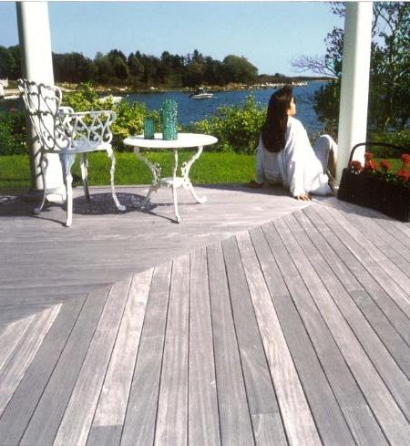
What Are My Appearance
Options?
The low-maintenance option.
The natural silver-gray patina can be achieved with hardwood decking or siding slowly, over time. This gracefully weathered wood look is a low-maintenance option that occurs naturally with time and exposure.
How much time? It’s almost impossible to predict but expect that it will take several years. Variables to consider are the amount of weather exposure, orientation, and UV the wood is exposed to. In general, the more UV exposure and weather, the faster the outdoor woods will ‘silver out’.
© 2020 General Woodcraft Inc

Slide 11
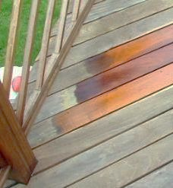
What Are My
Appearance
Options?
The “third” option: Changing your mind later.
It’s never too late to make a change with high performance exterior hardwoods. If the end consumer changes their mind on appearance preference, or they have lifestyle changes, or they don’t like the maintenance aspect of the ‘like new’ wood look, they can easily let hardwoods mellow naturally to a silvery gray patina as shown in the previous slides. They will only need to maintain the wood with annual cleaning and UV inhibitors.
© 2020 General Woodcraft Inc

Slide 12
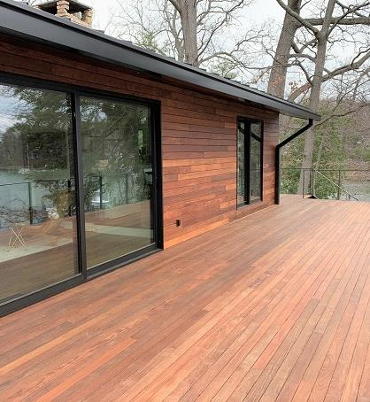
How The Look of
Wood Changes In The First Few Years
Year 1
As the sun and weather bleach the hardwood decking or siding the tannins (natural tints in the wood) will begin to change chemically.
The wood will begin to lighten up in color, usually in the first year or two.
© 2020 General Woodcraft Inc

Slide 13
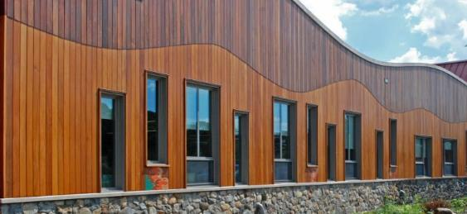
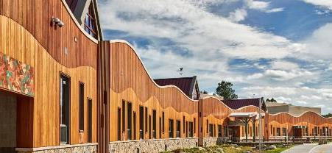
How The Look of
Wood Changes In The First Few Years
Sandy Hook School, 2 months after installation
(high density hardwood sidings)
Years 2 to 3
With continued exposure to the elements, the colors will continue to fade naturally.
Horizontal surfaces (like decking and rail caps), fade much faster than vertical surfaces, like siding and fascia boards.
Sandy Hook School after 2 years
of Connecticut weather exposure
© 2020 General Woodcraft Inc

Slide 14
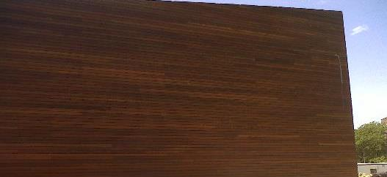
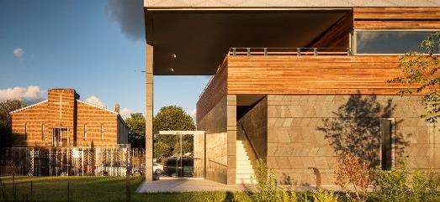
How The Look of
Wood Changes In The First Few Years
Ipe siding at Weeksville Center, NY
(during initial installation)
Year 3 and beyond…
The choice is yours.
You can continue to refinish to maintain the same appearance of the wood throughout its life.
Or, you can stop refinishing and only maintain the wood with annual cleaning and UV inhibitors, which allows the wood to weather naturally over time.
Ipe siding at Weeksville Center, NY
after 3-1/2 years
© 2020 General Woodcraft Inc

Slide 15
How High-Density Woods Weather
Different hardwoods start out with different colors when they are new.
When allowed to weather naturally though, nearly all exterior high-density hardwoods will weather out to a very similar silvery gray patina over time.
The next few slides will break down each type of hardwood and their color changes.
© 2020 General Woodcraft Inc

Slide 16
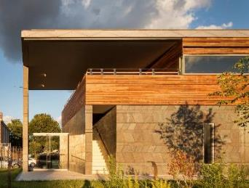
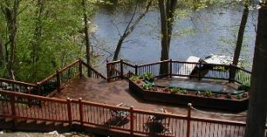
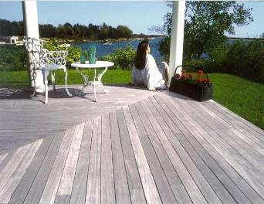
How Do High-Density Hardwoods Weather?
IPE
Ipe hardwood starts out as olive to light brown to nearly black colors when it is new.
Ipe decking or siding will age nicely to a gray patina. Because Ipe is a high-density exterior hardwood, it will remain highly durable for decades.
© 2020 General Woodcraft Inc

Slide 17
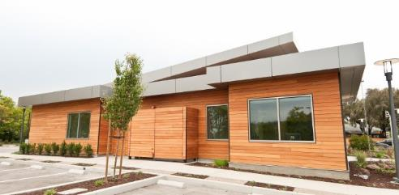
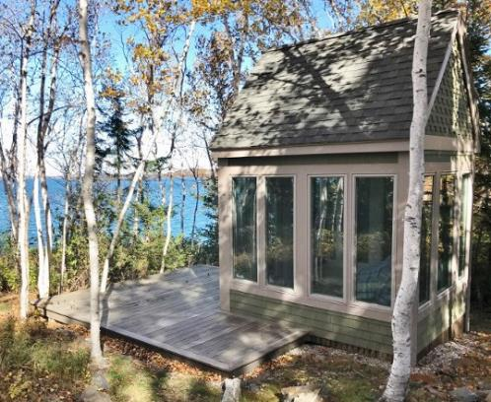
How Do High-Density Hardwoods Weather?
GARAPA
Garapa hardwood starts out with yellowish, honey and amber colored tones when it is new.
Garapa hardwood will weather out to a very similar silvery gray patina to Ipe over time.
© 2020 General Woodcraft Inc

Slide 18
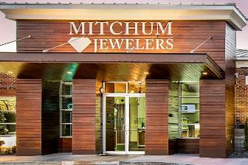
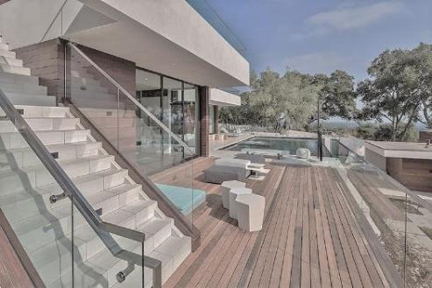
How Do High-Density Hardwoods Weather?
MACHICHE
FSC® Machiche high-density hardwood starts as a reddish brown to chocolaty brown color.
When allowed to age naturally, Machiche weathers out to a silvery gray patina over time.
© 2020 General Woodcraft Inc

Slide 19
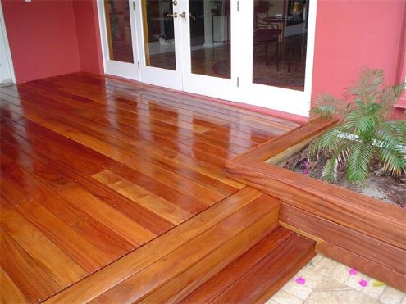
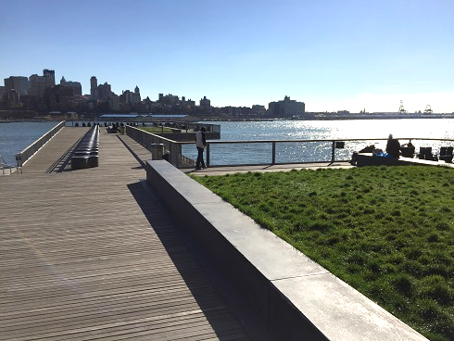
How Do High-Density Hardwoods Weather?
CUMARU
Red Cumaru hardwood begins as a reddish-brown color as shown. It can be refinished periodically to maintain this type of appearance.
Or, if you prefer to allow it to weather naturally, Cumaru will eventually ‘silver up’ over time.
© 2020 General Woodcraft Inc

Slide 20
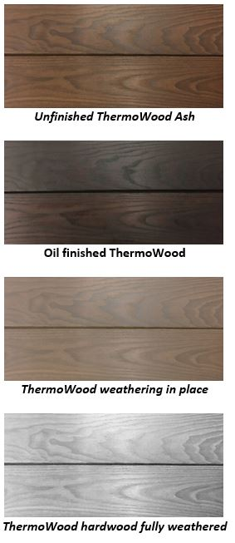
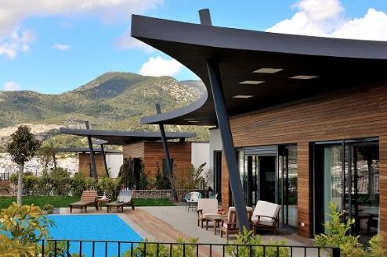
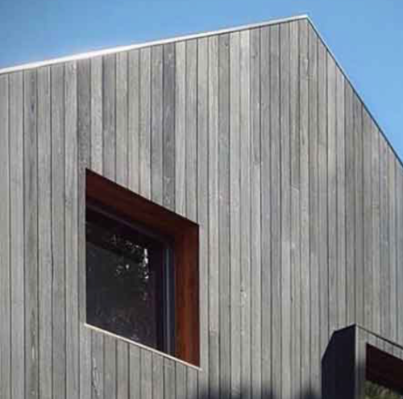
How Do High-Density Hardwoods Weather?
THERMOWOOD
ThermoWood natural hardwood darkens up to a chocolate brown color during the thermo process. Maintaining the darker color requires an occasional oil finish.
Because the modification process ‘cooks out’ the tannins, ThermoWood will weather quickly to a lovely silvery patina if let unfinished. This normally occurs in approximately a year or two.
© 2020 General Woodcraft Inc

Slide 21
END OF SECTION
Return To The Page To Proceed To Testing
© 2020 General Woodcraft Inc

