Slide 1
PROPER WOOD ACCLIMATION FOR EXTERIOR WOOD
PROFESSIONAL TRAINING OUTLINE
© 2020 General Woodcraft Inc

Slide 2
Knowing Critical Acclimation Guidelines for Hardwood Materials
Wood is an amazing, all natural, renewable product but it’s still wood. All wood will move, expand, and contract, especially during its initial acclimation period on site. It is imperative to allow wood to acclimate properly before installing it. The better you treat your new wood siding or decking, particularly while it initially acclimates, the more likely you are to be thrilled with your end project. Although hardwood decking and siding species such as Ipe, Cumaru, Garapa, Machiche and others will last a long time and perform well, they all still need to acclimate properly for best results. Even Kiln Dried (KD) materials need to be properly acclimated. By completing this training outline, you will learn the professional best practices, the Do’s and Don’ts for contractors and end-use consumers, and tips from our Mataverde experts on acclimating your wood decking and siding materials to ensure the best possible outcome.
© 2020 General Woodcraft Inc

Slide 3
Expert Tips To Know About Exterior Wood Acclimation On Site
Proper Acclimation
Do’s & Don’ts
© 2020 General Woodcraft Inc

Slide 4
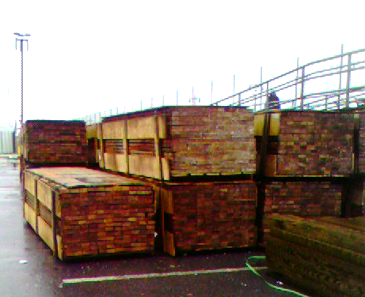
Expert Do’s and Don’ts
DO: Always allow your decking or siding wood to properly acclimate on site prior to installation. A week to two weeks is usually enough, if your wood is stored properly during this period
DON’T: Never install your wood decking or siding immediately. If your outdoor wood acclimates too quickly, you may get excessive surface checking, cupping, twisting, warping or other problems.
© 2020 General Woodcraft Inc

Slide 5
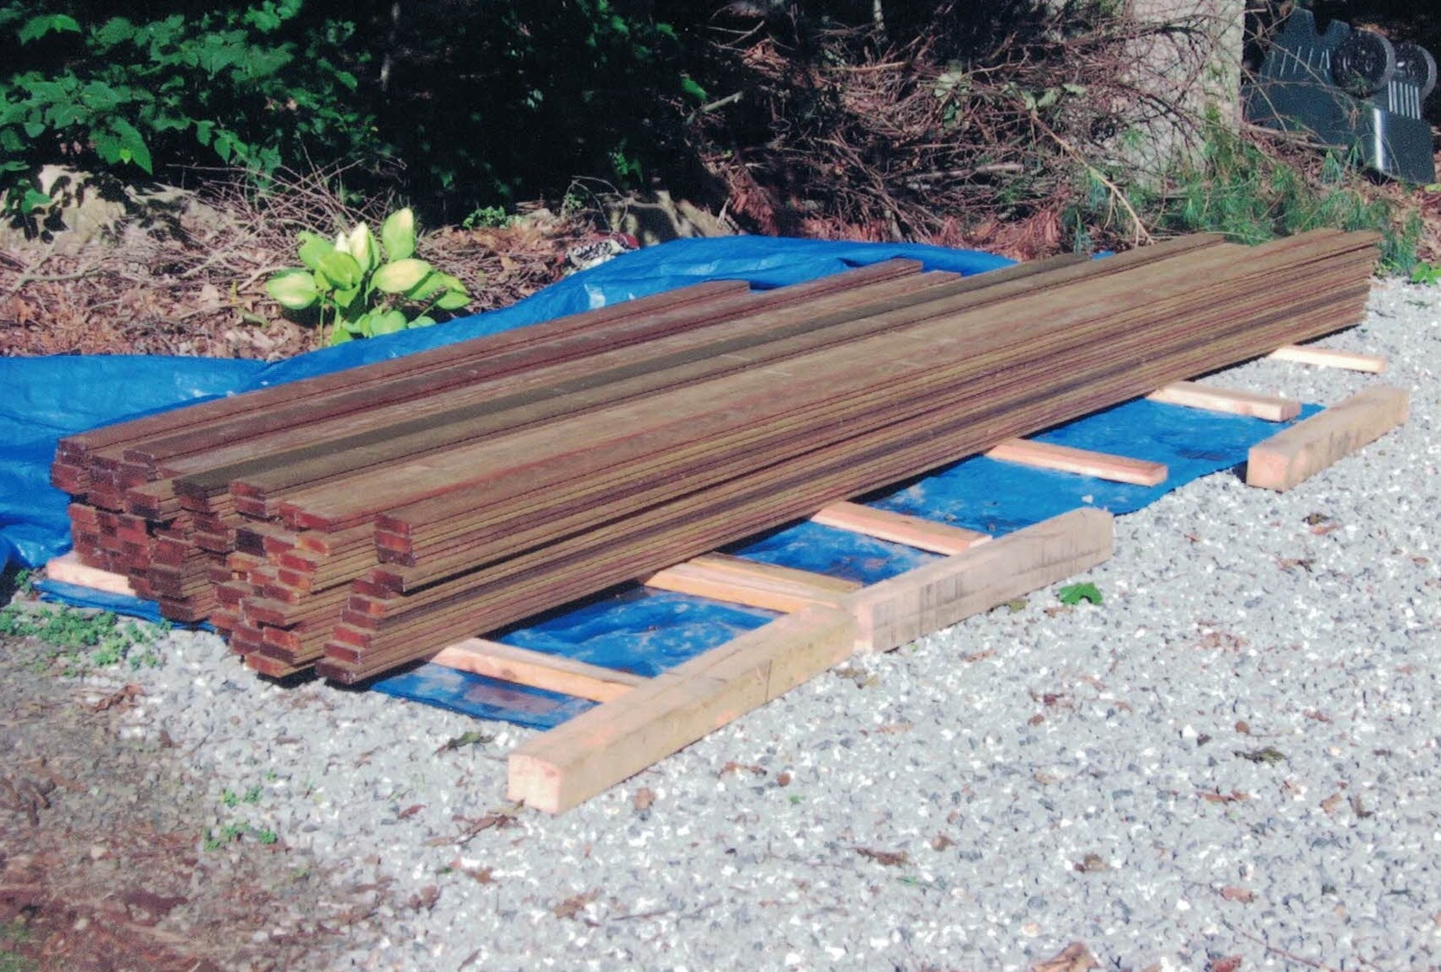
Expert Do’s and Don’ts
DO: Always store your deck or siding wood up off the ground. If you must let your wood acclimate over dirt or lawn areas, always keep your wood stacked a minimum of 8” to 12” off the ground. A tarp on the ground (below your pile) will also help reduce moisture from rising up into the materials.
DON’T: Never store your wood decking or siding directly on the ground, driveway, or concrete. If water settles on hard surfaces, your decking or siding will literally be sitting in a puddle of water. If you store wood too close to the ground, it will “wick” moisture out of the earth and wreak havoc.
© 2020 General Woodcraft Inc

Slide 6
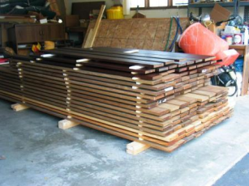
Expert Do’s and Don’ts
DO: Always use “spacers” or “stickers” between rows of decking or siding. This allows air flow between layers of wood, which will help the acclimation process along. Align these stickers directly over one another to keep wood straight.
DON’T: Never stack rows of decking or siding directly on top of one another. Stacking wood without spacers will not allow it to breathe and acclimate properly. Align the stickers properly to prevent the wood from warping during acclimation.
© 2020 General Woodcraft Inc

Slide 7
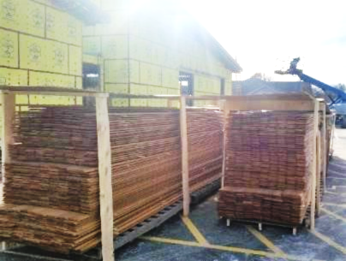
Expert Do’s and Don’ts
DO: Always cover the top of your stack of wood decking and siding ONLY. Leave the sides and ends open to let the air move. This is like an umbrella at the beach, it keeps off the sun, but lets the breezes through. If there is an area on the property that gets a breeze, this is the ideal area for gentle acclimation.
DON’T: Never cover the entire pile of wood decking or siding while it acclimates. You must leave the sides and ends of the stacks open. Covering the entire pile traps moisture and is often worse than no cover at all. It’s like locking the wood inside a steam bath. This is sure to cause cupping, swelling and lots of problems.
© 2020 General Woodcraft Inc

Slide 8
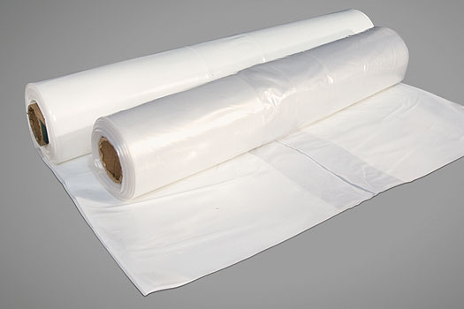
Expert Do’s and Don’ts
DO: Always use plywood, OSB, wood scraps or a canvas type of tarp only on the top of your stack of wood decking or siding.
DON’T: Never use clear poly film or plastic on top of your decking. This can create a greenhouse effect and ruin your wood. (FYI: This applies to both before and after installation.)
© 2020 General Woodcraft Inc

Slide 9
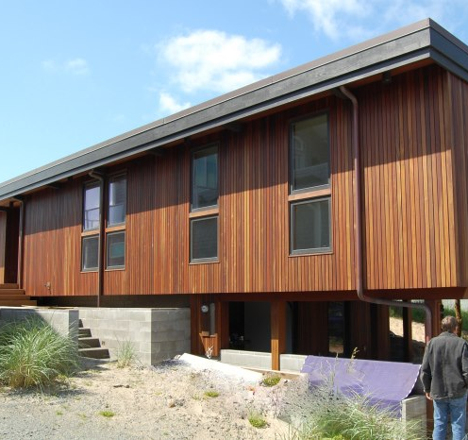
Expert Do’s and Don’ts
DO: Always use a UV inhibiting sealer on your hardwood decking or siding, even if you want the material to weather to a natural silvery patina. The UV inhibitors will help minimize surface checking and protect your wood after installation. For best results, a UV inhibitor should be applied before installation or immediately afterwards.
DON’T: Never let your wood decking or siding weather naturally without proper UV protection. This is like going to beach for the first time on the hottest day without sunscreen. Unprotected wood often dries out too quickly, creating problems. Your wood needs UV protection until it is fully acclimated to your site.
© 2020 General Woodcraft Inc

Slide 10
END OF SECTION
Return To The Page To Proceed To Testing
© 2020 General Woodcraft Inc

