Slide 1

WOOD RAINSCREEN 201
PROFESSIONAL TRAINING OUTLINE

Slide 2
SECTION 1:
What Is and Why Use Wood Rainscreen
Definitions, History, Drivers, and Benefits

Slide 3
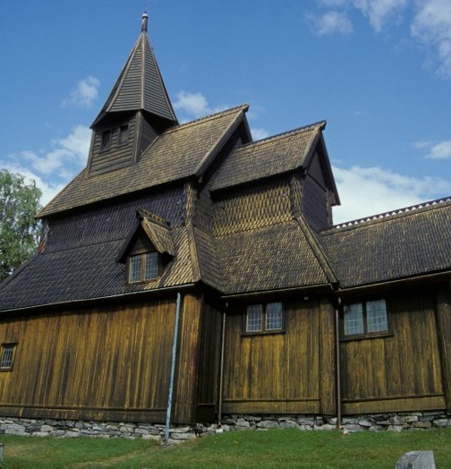
Original wood rainscreen on a stave church in Urnes, Norway, built circa 1180 AD
What Is A Rainscreen and
What Should I Know About Them?
A rainscreen, by definition, is a system not a single product, that helps protect the building envelope (exterior) from weather.
The passive insulation layer between the cladding and the envelope (the wall cavity or rainscreen gap) is where the magic happens.
Different rainscreen approaches perform differently.
Proper flashing and appropriate WRB’s (weather resistive barriers) are more important than ever.

Slide 4
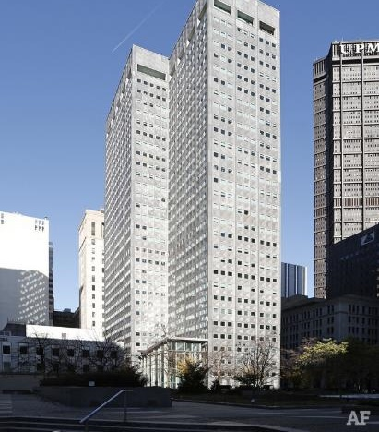
What is a Rainscreen?
The first rainscreen design in the U.S. was the Alcoa Building, built in Pittsburgh in the 1950s.
It has aluminum cladding
A back ventilated rainscreen
And a 12” rainscreen gap (exterior wall cavity).

Slide 5
Wood rainscreens have been used throughout Europe and Japan for many centuries.
Wood rainscreens have been in use for residential designs throughout Canada for several decades.
They were tested and found to be so effective they are now legislated and a mandated building code requirement in many parts of Canada (starting in BC)
In the U.S., these codes are creeping down the coast to WA, OR and CA in the past few years. More to come, stay tuned.
A Brief
Wood Rainscreen
History

Slide 6
Key Drivers:
Why Rainscreen is Specified
With code changes, U.S. architects are paying more attention to rainscreens.
The sustainable design movement in U.S. architectural circles enhanced the awareness of the benefits of a properly designed rainscreen in the architectural community.
Health, Safety and Welfare, (HSW), requirements rule the day in modern architectural learning and training, 18 credits per year.
Therefore, now rainscreens are frequently specified for both design benefits and code requirements.
Property owners and construction professionals are catching on.
Notes:
Key drivers for rainscreen specs are-
The biggest buzzword we heard repeatedly at IBS was “health” and “healthy”

Slide 7
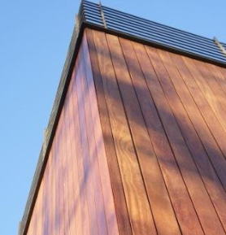
Benefits To A
Well-Designed Rainscreen
Protects the exterior from wind-driven rain, sleet, snow and other weather.
Provides an egress behind the cladding for bulk water to escape.
Allows interior moisture to egress the outside of the building envelope.
Provides a passive thermal layer in the rainscreen gap (wall cavity).

Slide 8
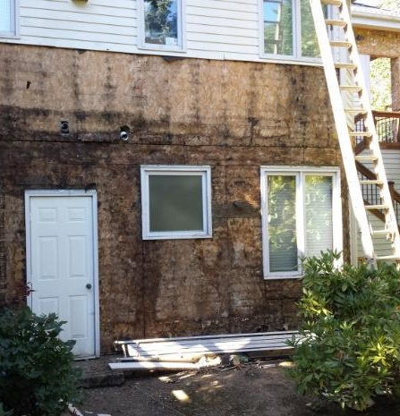
Consequences Of Not Using
A Rainscreen
The structure can’t “breathe”.
Trapped moisture has no where to escape.
Leads to mold, then to rot, then to decay causing:
  Health concerns
  Structural issues
Mold lawsuits are a $ Billion industry.
Notes:
Have you ever seen anything like this?

Slide 9
SECTION 2:
Different Types of
Wood Rainscreens
Approaches, Materials, Features
And How They Work

Slide 10
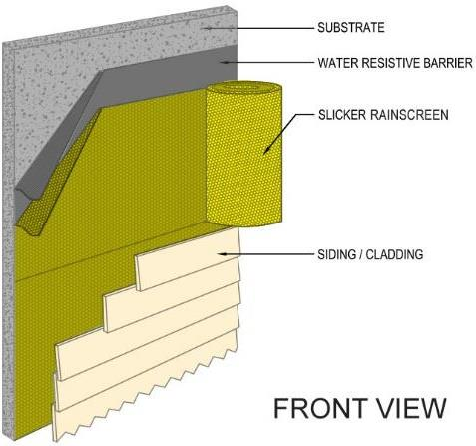
Basic Wood Rainscreen Type:
Wood siding with a back ventilated rainscreen
Protects the exterior from weather
The system, (WRB), slicker and siding, work together to create a rainscreen.
Back ventilated
Closed joint
Non-pressure equalized
Minimal rainscreen gap
Better alternative than not having a rainscreen gap (wall cavity)
FYI: “Slicker rainscreen” by itself is not a rainscreen. The rainscreen system you see here is the WRB, the rainscreen gap formed by the Slicker and the cladding

Slide 11
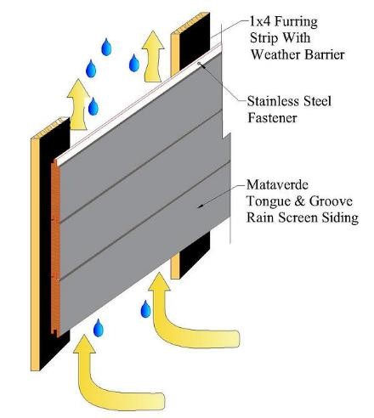
Basic Wood Rainscreen Type:
Wood siding over furring strips
Protects the exterior from weather
Back ventilated
Closed joint
Non-pressure equalized
Furring strips cover about 20% of the building envelope, so…
From an egress standpoint of moisture from the inside, this method is only 80% effective, by design, because of the furring strips

Slide 12
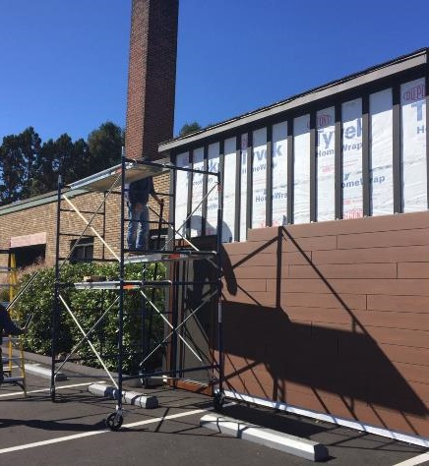
Basic Wood Rainscreen Type:
Trespa Pura siding over furring strips
Protects the exterior from weather
Fully back ventilated (at top and bottom of each furring strip cavity)
Open joint – because there is spacing between the siding boards, this allows for some pressure equalization
Not fully pressure equalized (furring strips restrict air exchange into their ‘channels’ only)

Slide 13
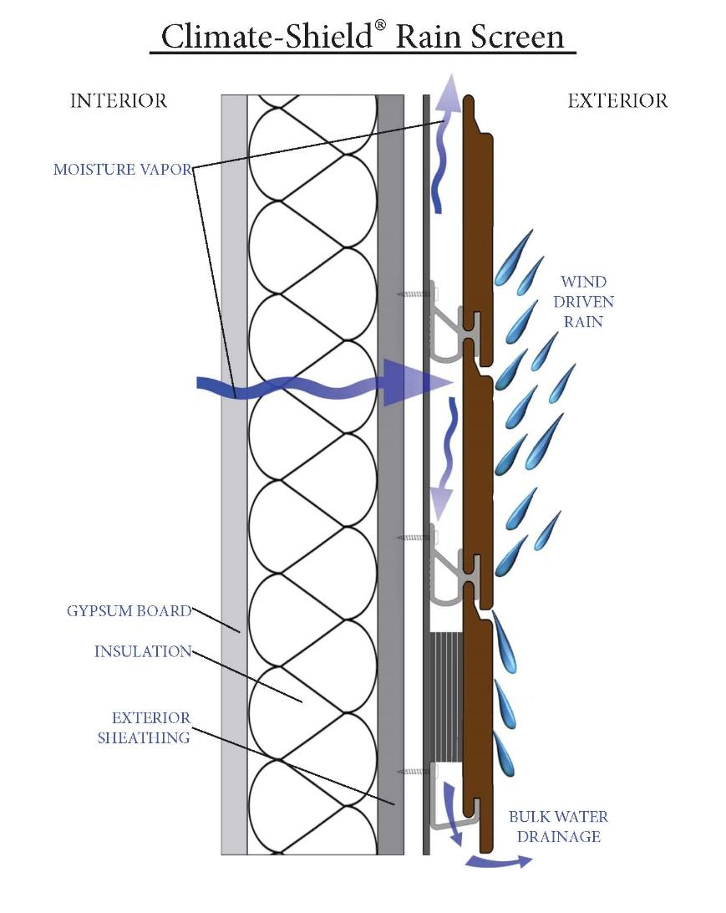
How Does a Well Designed Rainscreen Work?
The siding (sheds most bulk water)
Back ventilated (drains)
Open joint (breathes)
Pressure equalized (dries quickly, better wind load performance)
These three, when combined, create the highest performance criteria for wood rainscreens

Slide 14
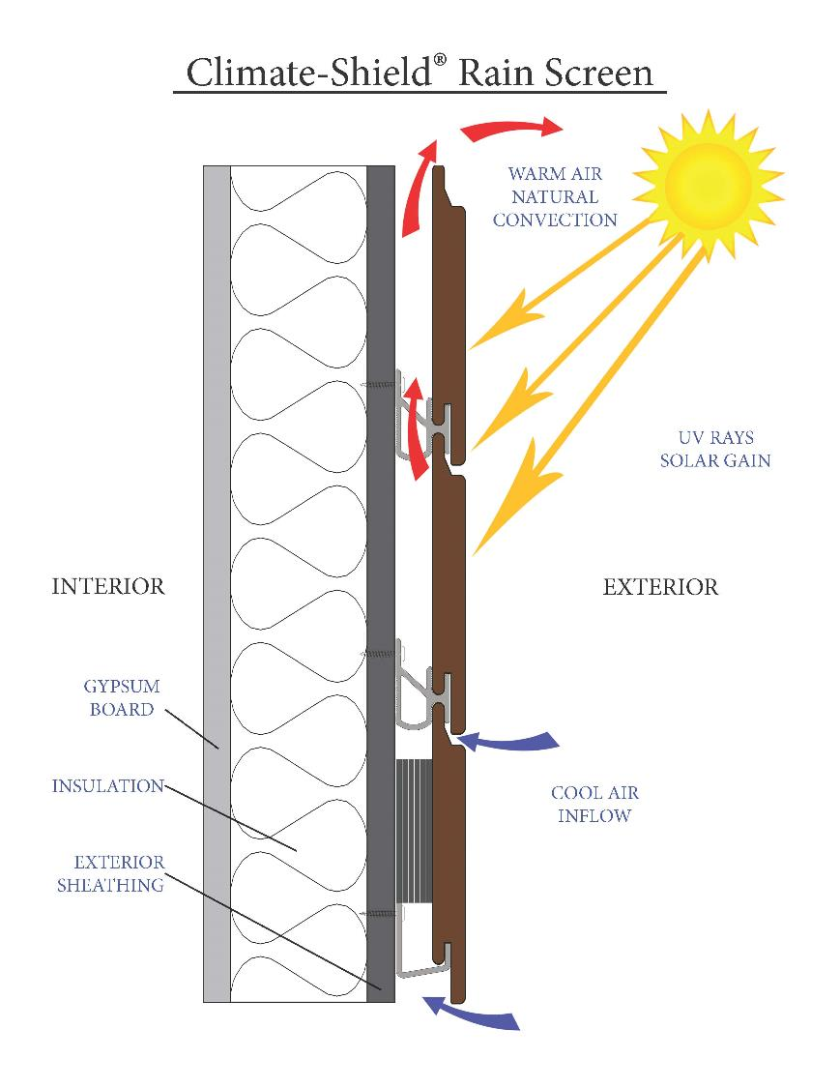
How Does a Well Designed Rainscreen Work?
“Rainscreens” (not just for rain)
Back ventilated (drains and vents)
Open joint (better ventilation)
Pressure equalized (dries quickly, better wind load performance)
Natural Energy savings in cold or warm weather

Slide 15
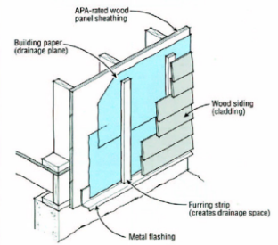
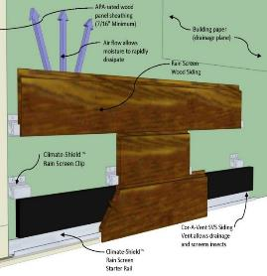
Different Types of Wood for Rainscreens
Similarities of Furring Strips vs. Non-Furring Strips
The building envelope is weatherproofed to keep the weather from entering the interior of the structure
The outer siding keeps the weather away from the structure
The open space between the layers of the rain screen system allows some trapped moisture to escape and creates an energy-efficient air space that acts as an insulator. This layer helps buffer the transmission of both cold and heat.
X The furring strips restrict air flow to each individual cavity.
X Adds material costs, labor costs and construction time
X Wet furring strips are an excellent food source for mold and mildew, which may lead to rot, decay and insect damage
Climate-Shield™ rain screen clips eliminate the need for furring strips
Saves material costs, labor cost and construction time
No furring strips eliminates a food source for mold, mildew and rot
Climate-Shield™ Clips allow free movement of air to accelerate moisture dissipation time

Slide 16
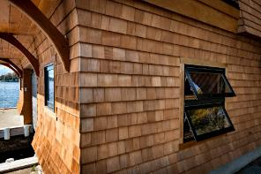
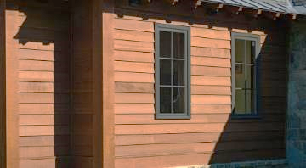
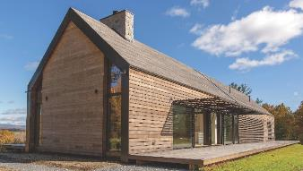
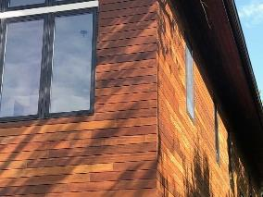
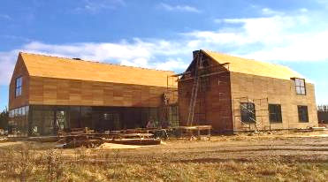

Different Types of Wood Sidings for Rainscreens
Cedar Shingles | Cedar Clapboard | Thermally Modified
Ipe hardwood | Garapa hardwood | Machiche hardwood

Slide 17
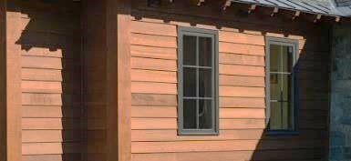
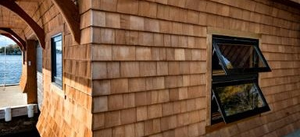
Different Types of Wood for Rainscreens
Cedar Shingles, Shakes and Clapboard
PROS:
Natural wood
Easy to work with, easy to paint or stain
Can be installed in a basic rainscreen
It’s beautiful
CONS:
Softwood, may dent or scratch easily
Requires periodic refinishing to last longer
Typically installed with a ‘skinny’
rainscreen gap
Availability is dwindling

Slide 18
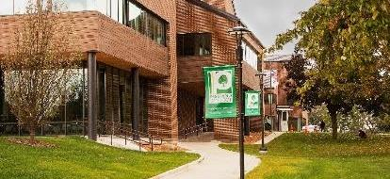
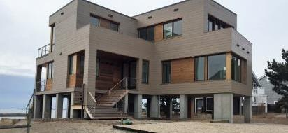
Different Types of Wood for Rainscreens
Cedar Softwood Siding boards
PROS:
Natural wood
Easy to work with, easy to paint or stain
Can be installed in a high performance rainscreen
It’s beautiful
CONS:
Softwood, may dent or scratch easily
Requires periodic refinishing to last longer
Cedar availability is dwindling

Slide 19
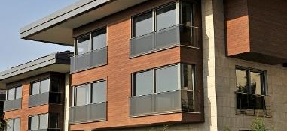
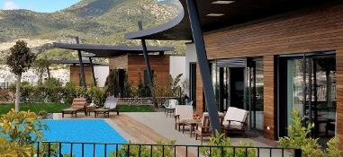
Different Types of Wood for Rainscreens
Thermally Modified Wood Siding
PROS:
Naturally beautiful, real wood
Less expansion and contraction than ‘regular’ wood
Can be installed in many rainscreen designs
The ThermoWood process makes the wood more durable and stable
CONS:
Slightly more brittle after modification
Turns gray faster than non-modified woods

Slide 20
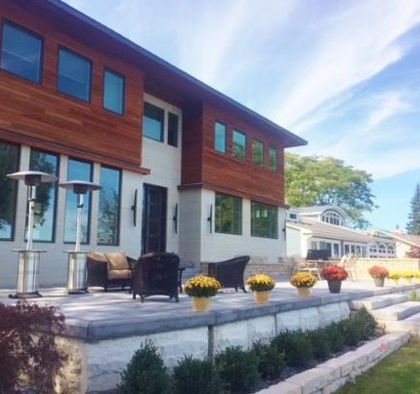
Different Types of Wood for Rainscreens
High Density Hardwood Siding
PROS:
Naturally beautiful hardwoods – many species
Exceptionally durable and insect resistant
Can be installed in many rainscreen designs
Can be pre-finished to deepen and ‘blend’ the appearance
Can be allowed to ‘silver out’ without effecting the longevity of the siding
CONS:
Requires periodic refinishing to maintain a ‘like new’ wood look

Slide 21
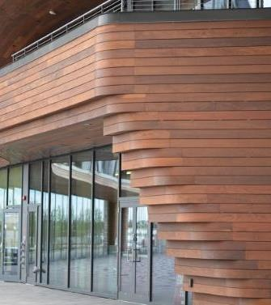
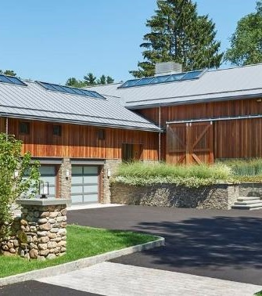
Different Types of Wood for Rainscreens
Ipe High Density
Hardwood Siding

Slide 22
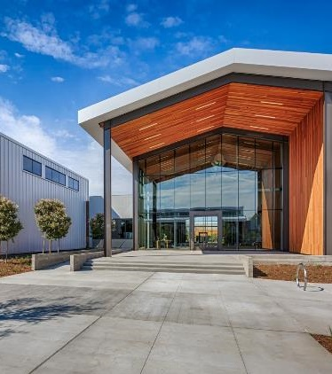
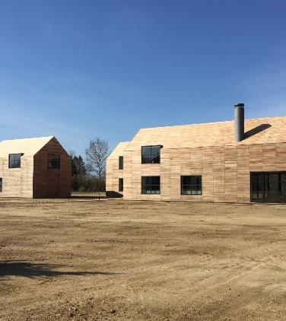
Different Types of Wood for Rainscreens
Garapa High Density Hardwood Siding

Slide 23
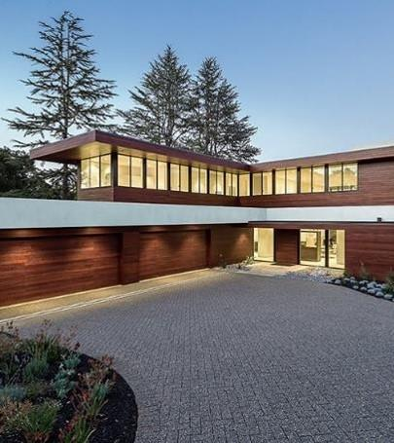
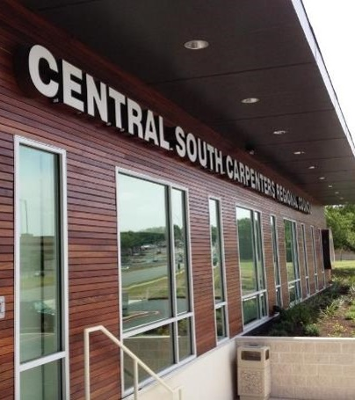
Different Types of Wood for Rainscreens
FSC® Certified Machiche High Density Hardwood Siding

Slide 24
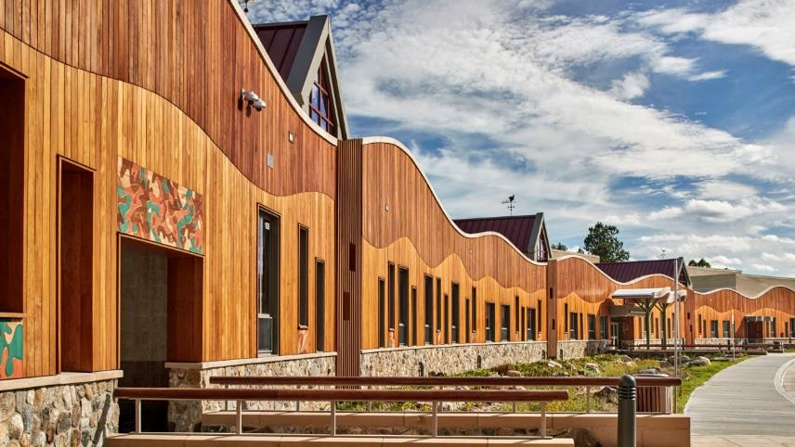
Different Types of Wood for Rainscreens
FSC® Certified Garapa and FSC® Certified Machiche High Density Hardwood Siding

Slide 25

SECTION 3:
Why Use
Trespa Pura NFC® Cladding
Materials, Finishes, Benefits and Facts

Slide 26
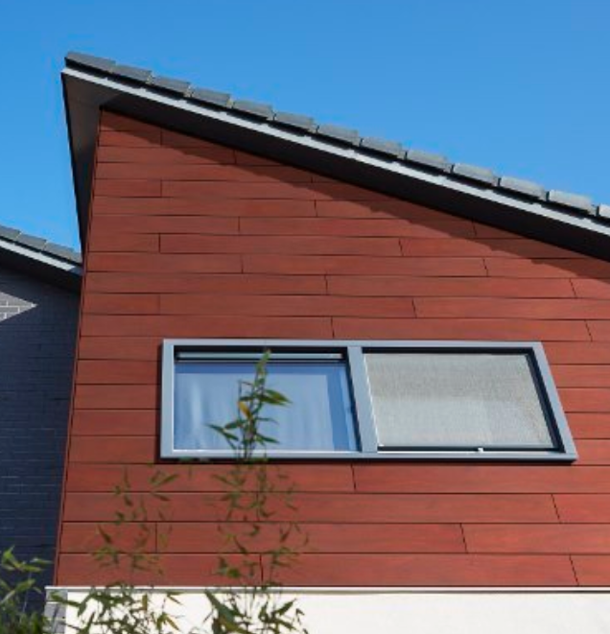
Why Use Trespa
Pura Cladding
Benefits of the Trespa Pura Cladding
The warm look of wood without the usual maintenance.
Available in 8 wood décor options
Trespa is an HPL (High Pressure Laminate) with a natural fiber core (NFC)
Every Trespa panel undergoes over 100 tests during the manufacturing process
Electron Beam Curing makes the finish color fast
Meets Higher Test Standards than required (See MDS sheet on our website for details)
Exceptionally easy to maintain – soap and water

Slide 27
What’s so Special about Trespa Pura?
Why Use Trespa
Pura Cladding
The warm look of wood without the usual maintenance.

Slide 28
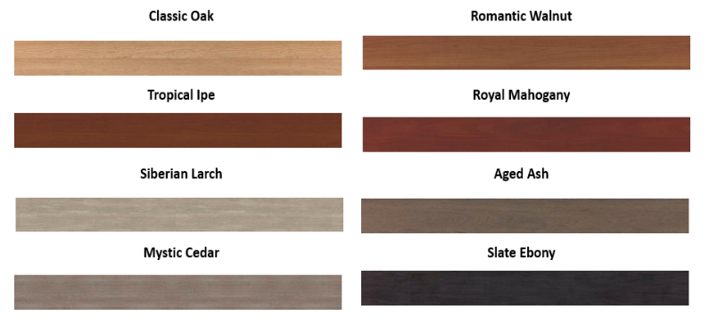
Why Use Trespa
Pura Cladding
Available in 8 wood décor options

Slide 29
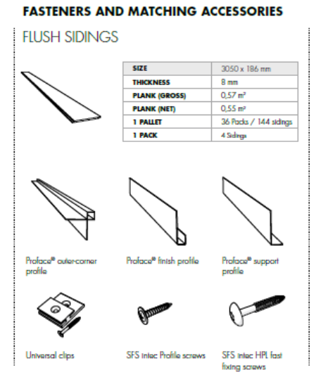
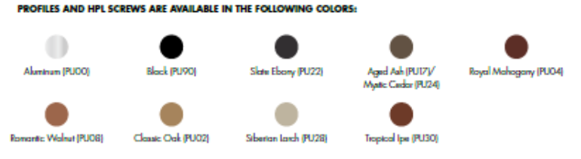
Why Use Trespa Pura Cladding
Black, Mill Finish or other matching color trim, screws and accessories

Slide 30
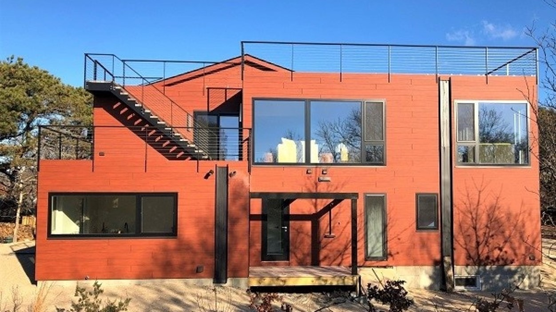
Why Use
Trespa Pura
Cladding
Shown here in Royal Mahogany.

Slide 31
Why
Trespa Pura
Cladding
Shown here in
Aged Ash.

Slide 32
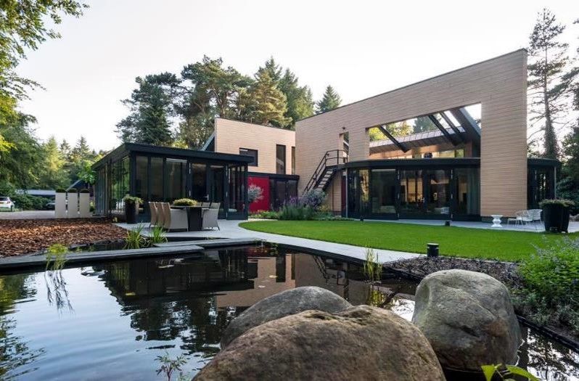
Why Use
Trespa Pura
Cladding
Shown Here in Classic Oak.

Slide 33
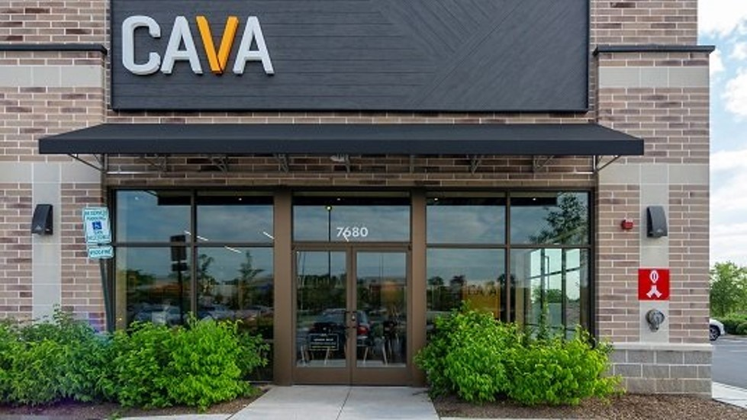
Why Use
Trespa Pura
Cladding
Shown Here in
Slate Ebony

Slide 34
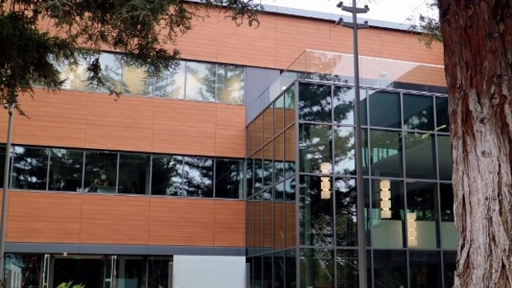
Why Use
Trespa Pura
Cladding
Shown Here in
Romantic Walnut

Slide 35
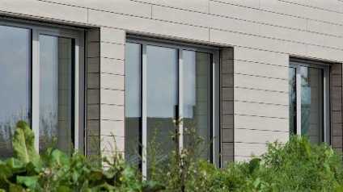
Why Use
Trespa Pura
Cladding
Shown Here in
Siberian Larch

Slide 36
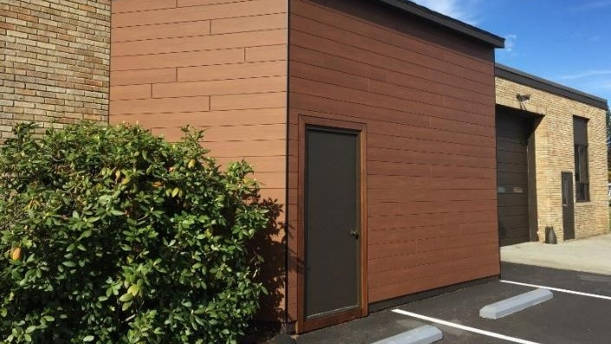
Why Use
Trespa Pura
Cladding
Shown Here in
Tropical Ipe

Slide 37
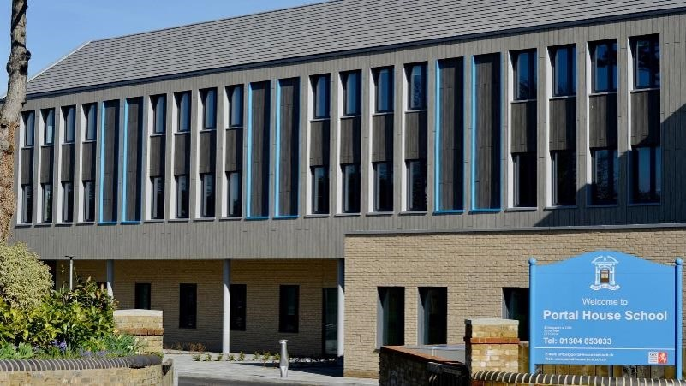
Why Use
Trespa Pura
Cladding
Shown Here in
Mystic Cedar

Slide 38
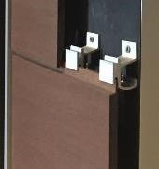
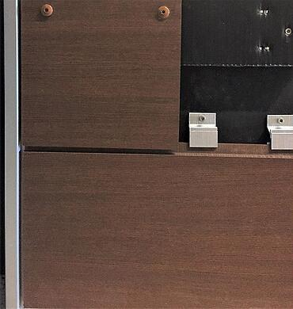
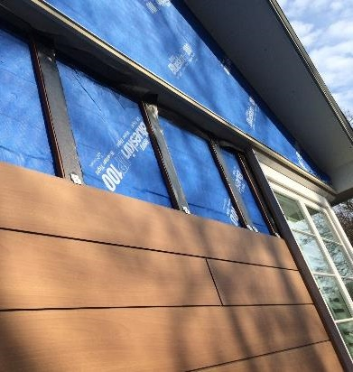
Why Use Trespa Pura Cladding
Installs easily with traditional wood furring strips
or our Climate-Shield System

Slide 39
Why Use Trespa Pura Cladding
Installs easily with traditional wood furring strips or Climate-Shield System
FURRING STRIPS EVERYWHERE METHOD
For Trim:
Hardwood furring strips
Delta Façade Tape
For Field Siding:
Hardwood furring strips
Delta Façade Tape
Trespa Universal Clips
CLIMATE-SHIELD METHOD
For Trim Only:
Hardwood furring strips
Delta Façade Tape
For Field Siding:
CS8 8’ Starter rail
CST1 Clips

Slide 40
END OF SECTION
Thank you for completing this online training.
Are you ready? Please Proceed To The Test
Brought to you by General Woodcraft, Inc. New London, CT and Cotati, CA

